Slide 1
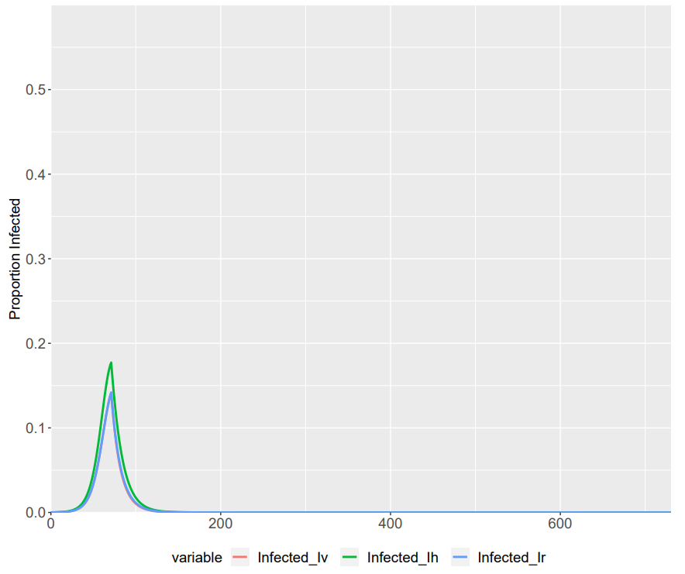
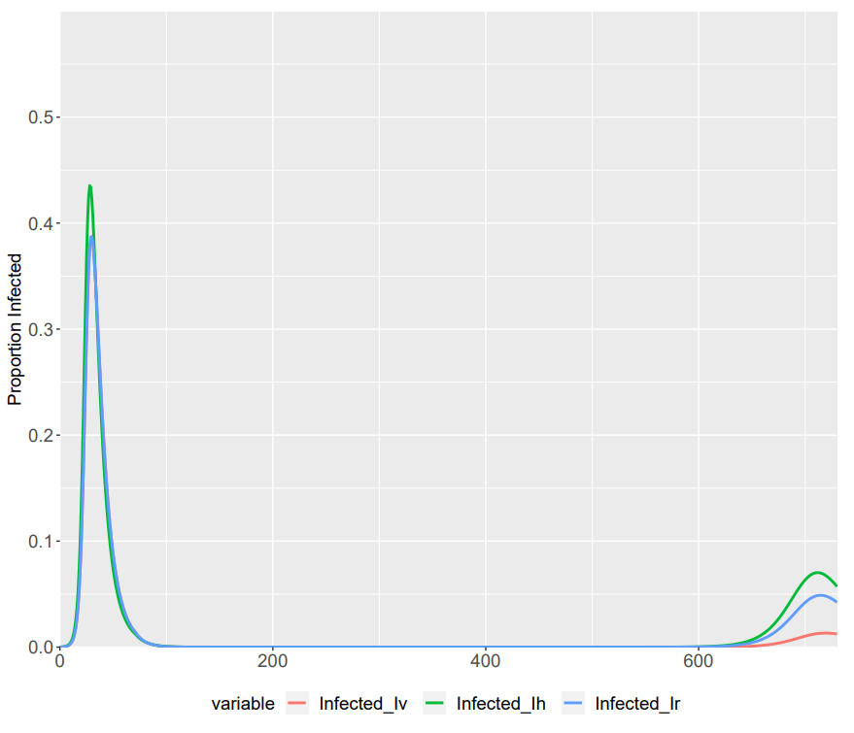
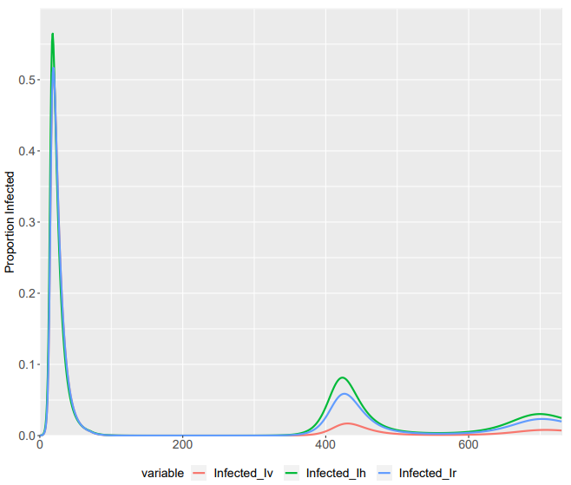
 | Vulnerable | Shielders | Remainders
Vulnerable | β₁ * (1- δ) * σ | β₁ * σ | β₄δ * σ
Shielders | β₁* σ | β₂* σ | β2 * σ
Non-Vulnerable | β₄δ * σ | β₂ * σ | β₃ * (1- δ) * σ
For delta = 1
Sigma = 0.5
Sigma = 1
Sigma = 1.5

Slide 2
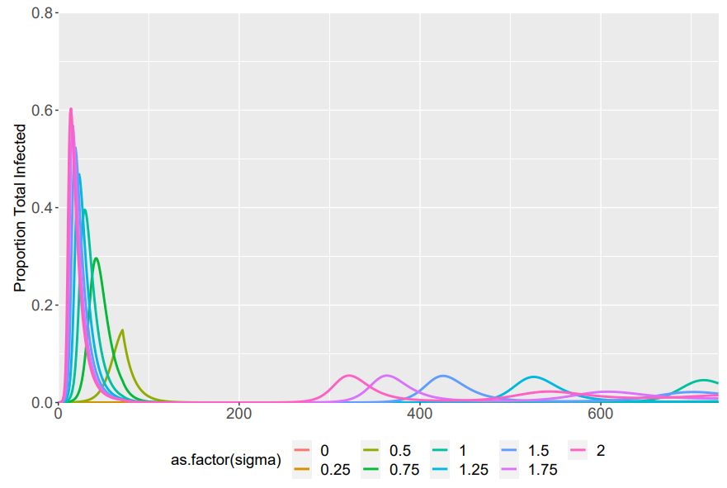
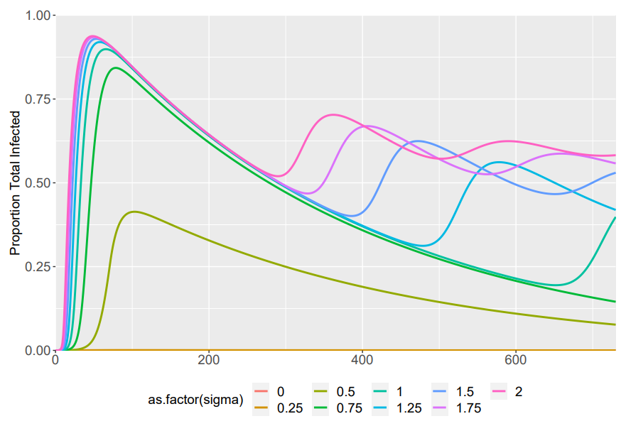
Sigma ranged from 0 -> 2
Total Infected
Total Recovered

